Slide 1
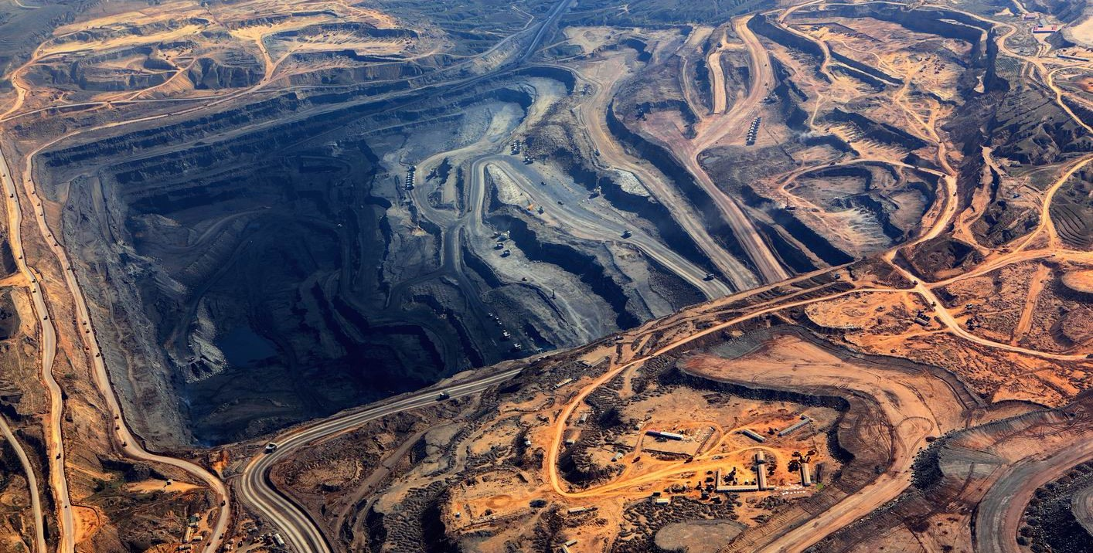

Notes:
Borrar sombras

Slide 2

ALAYA MIINIG ANALYTICS
LOAD AND TRANSPORT
LOAD AND TRANSPORT
GRIDING
FLOATING
GLOMERS
LEACHING
MAINTENANCE
SAFETY

Slide 3
TRANSPORT OPTIMIZER
ALAYA MIINIG ANALYTICS
LOAD AND TRANSPORT
TRANSPORT OPTIMIZER
GRIDING
FLOATING
GLOMERS
TIRES MAINTENANCE
ROUTES OPTIMIZATION AND SAVE COSTS
LEACHING
MAINTENANCE
SAFETY
9

Slide 4
TRANSPORT OPTIMIZER
ALAYA MIINIG ANALYTICS
LOAD AND TRANSPORT
Benefits
5 - 10 [%] increase in tyres lifetime
Fuel consume reduction 3 %
2 - 6 % haulage time reduction
Optimization of tires maintenance Schedule
Ensure operational continuity and visibility of borderline operational conditions
Drivers and shovels operational excellence improvement
Road improvements and maintenance recommendations.
Recomendation to dispatch optimal production routes
Support on production goals compliance
GRIDING
FLOATING
GLOMERS
LEACHING
MAINTENANCE
SAFETY
10
Notes:
We give operational feedback

Slide 5
ITINERAY OPTIMIZATION
ALAYA MIINIG ANALYTICS
Design process
LOAD AND TRANSPORT
Georeferential data [GPS]
Neural nets to predict travel times
Genetic algorithm to take predictions and construct time-efficient trip itinerary
GRIDING
FLOATING
DATA
MACHINE LEARNING
OPTIMIZATION
GLOMERS
LEACHING
GEOREFERENTIAL DATA [GPS]
STACKED NEURAL NETWORK
CONVOLUTIONAL + FULLY CONNECTED
EVOLUTIONAY
ALGORITHM
MAINTENANCE
SAFETY
11

Slide 6




TRANSPORT OPTIMIZER
ALAYA MIINIG ANALYTICS
LOAD AND TRANSPORT
How does it work?
GRIDING
GEOREFERENTIAL DATA [GPS]
FLOATING
LOADS AND DISCHARGES OF MINERAL
ALAYA CLOUD SERVICES
[AZURE / AWS]
TIRES TEMPERATURE AND PRESSURE
ANALYTICS
GLOMERS
CUSTOMER DATA
CUSTOMER ON PREMISE SERVERS
FUEL MONITORING [OPTIONAL]
LEACHING
ENGINES MONITORING [OPTIONAL]
MAINTENANCE
SAFETY
11

Slide 7
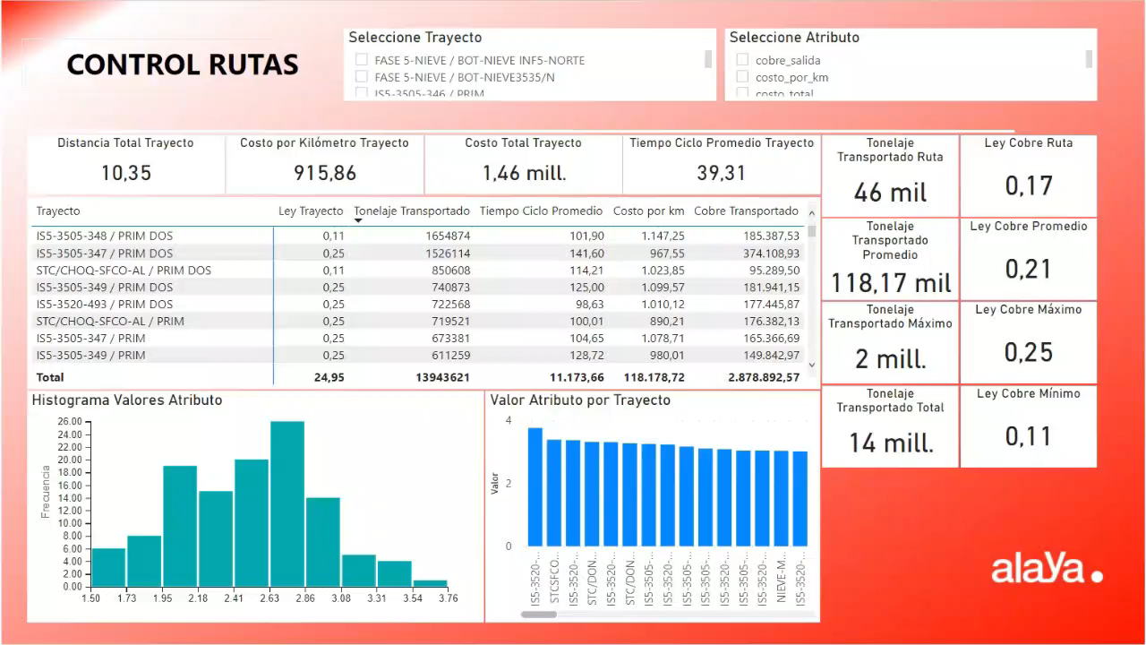
TRANSPORT OPTIMIZER
ALAYA MIINIG ANALYTICS
LOAD AND TRANSPORT
GRIDING
FLOATING
GLOMERS
LEACHING
MAINTENANCE
SAFETY
12

